Slide 1
Industrial Training Briefing for
Sem 2 2016/2017
By Dr. Aznul Qalid Md Sabri
Head,Industrial Training Coordinator FCSIT
4th November, 2016
Slides originally prepared by: Dr. Su Moon Ting

Slide 2
Industrial Training Coordinators
SE: Dr. Su Moon Ting
  smting@um.edu.my
CST: Mr. Emran Mohd Tamil
  emran@um.edu.my
IS: Dr. Nordiana Ahmad Kharman Shah
  dina@um.edu.my
Multimedia: Dr. Mohamad Nizam Hj. Ayub
  nizam_ayub@um.edu.my
AI: Dr. Aznul Qalid Md Sabri
  aznulqalid@um.edu.my

Slide 3
Outline
Students’ responsibilities
Flowchart
Students’ schedule
Emails
Assessment
Repeat Industrial Training
Leave during Industrial Training
Internship Abroad – SV and other countries
Industrial Training Web Site
Reminder
Q & A

Slide 4
Important details can be found at:
http://intra.fsktm.um.edu.my/LatihanIndustri/ind.php

Slide 5
Students’ Responsibilities
Apply for placement
  one semester before the Industrial Training Programme for local placement,
  and at least two semesters before the Industrial Training Programme for abroad placement.
  Refer to
    2. Flow Chart for Applying Industrial Training Placement.

Slide 6
Students’ Responsibilities
It is the student’s responsibility to make sure the company is
  a suitable place for industrial training related to his/her field of study,
  the placement is related to his/her field of study,
  and it is a safe place for industrial training.

Slide 7
Students’ Responsibilities
Unsuitable Companies
  Cannot take up a placement where there is potential conflict of interests.
  For e.g.: cannot undergo training in family/relative companies, a company where you have worked/is currently working, etc.

Slide 8
Students’ Responsibilities
Unsuitable Companies
  FCSIT students are not allowed to undergo Industrial Training in University of Malaya including spin-off companies, except for certain cases which are approved.
  Placement at organizations such as Majlis Daerah, etc, are strongly not encouraged and most likely will not be approved.

Slide 9
Students’ Responsibilities
Get the advice from the Dept. Industrial Training Coordinator if unsure of the suitability of a company.
Inform the Dept. Coordinator if unable to get a placement for Industrial Training.

Slide 10
Students’ Responsibilities
Can apply a few companies but choose only ONE place for Industrial Training.

Slide 11
Students’ Responsibilities
Email offer letter to Dept. Industrial Training Coordinator to get approval
  for the offer before starting the training.
If you do not get the approval, even though you have started your training, it is invalid.
And if the coordinator reject your placement,
  you have to find another placement even though you have started your training.

Slide 12
Students’ Responsibilities
Offer letter MUST state
  1) the start and end dates of the student’s Industrial Training,
  2) Plan of tasks: Tasks that will be assigned to the student in general,
  3) the department the student will be placed.

Slide 13
Students’ Responsibilities
If item 2) and 3) are not in offer letter, company (not student) can email them to coordinator, and attach the offer letter.
Without all the requested information, the offer will not be approved.
  So, please provide the coordinator with all the information, otherwise it will delay the approval until all information is provided.

Slide 14
Students’ Responsibilities
It is the student’s and NOT the coordinator’s responsibility to make sure that the duration of training is at least 24 weeks.
  If less than 24 weeks, you do not fulfill the requirement and will fail your industrial training.
How to count 24 weeks?
  http://www.timeanddate.com/date/duration.html

Slide 15
Students’ Responsibilities
One or two weeks additional will usually be approved
  But... Please consider
    replacement of leave taken, and
    timing for convocation (for those doing industrial training in final semester of study which falls on 2nd semester of an academic year).

Slide 16
Students’ Responsibilities
Attend briefing related to Industrial Training.
Encouraged to attend one workshop and one corporate talk organised by CITra before Industrial Training. (Refer to emails sent by CITra).
CITra = Centre for the Initiation of Talent and Industrial Training

Slide 17
Students’ Responsibilities
Register online and submit all the needed documents to the Faculty and/or CITra.

Slide 18
Students’ Responsibilities
Get written permission from the Faculty to withdraw from the Industrial Training program or to change the location of placement or to reject an offer accepted previously.

Slide 19
Students’ Responsibilities
To change company,
  write to Deputy Dean (Undergraduate) (TDID) stating reasons,
  cc to Assistant Registrar (Mrs. Suhaini),
  Dept. LI coordinator and
  support staff (Mrs. Faridah), attach with termination letter, and new offer letter.

Slide 20
Students’ Responsibilities
Coordinator will support change of company if all the information is provided and new offer is suitable.
Office will do verification
  If ok, will pass to TDID for approval.
  Then send to CITra for approval and to change company in system.

Slide 21
Students’ Responsibilities
Follow the training requirements.
Carry out the tasks and the responsibilities assigned by the company under the supervision of one or more Company Supervisors.

Slide 22
Students’ Responsibilities
Adhere to all the rules and regulations of company as long as not contradicting with the rules of the University.
Always be positive and give the best contribution in carrying out the tasks given.

Slide 23
Students’ Responsibilities
Carry out Industrial Training in an ethical and professional manner and uphold the good name of the University at all time.

Slide 24
Students’ Responsibilities
Inform Dept. Industrial Training Coordinator/ Faculty Supervisor immediately if facing any problem.
The Coordinator’s email can be found on the Industrial Training website of FSKTM.

Slide 25
Students’ Responsibilities
Record all activities that have been carried out in Log Books and email to the Faculty Supervisor following the schedule in 3. Students’ Schedule.
Write the Industrial Training Final Report and conduct other tasks assigned.

Slide 26
Students’ Responsibilities
Contact the appointed Faculty Supervisor for the arrangement of the supervisor’s visit to the place of the Industrial Training.
A student who fails to arrange for the visit of the supervisor from the faculty before the end of his or her Industrial Training will fail Industrial Training.

Slide 27
Students’ Responsibilities
Be present at the training place during the Faculty Supervisor’s visit and conduct presentation and demonstrate devices or systems that have been used or learnt.
Show the Log Book to be checked by the Faculty Supervisor during the supervisor’s visit.

Slide 28
Students’ Responsibilities
Adhere to the Industrial Training rules and regulations set by the Faculty, CITra, and the University.
Always visit CITra website and Industrial Training website of the Faculty to get the latest information.

Slide 29
Students’ Responsibilities
Perform the required details following the schedule in 3. Students’ Schedule.

Slide 30
Flow Chart for Applying Placement
Refer to 2. Flow Chart for Applying Industrial Training Placement.
For the time being, apply to company manually, get the offer letter and email it to dept. coordinator. If offer approved by coordinator then only enter the placement into the system (CITRA).
Attach Referral Letter when apply to company since it contains important information for the company.

Slide 31
Students’ Schedule
Refer to 3. Students’ Schedule.
Templates for Plan of Tasks and Log Book, and guidelines for Final Report can be downloaded from FSKTM Industrial Training website.

Slide 32
Emails
  When sending email to dept. coordinator/office
    Please state name, matric number, programme (CS/IT/B.ISIT) & your specialization (AI/SE, etc).
    Try as much as possible to send email using the same thread of email, i.e. don’t create new email unless no choice.
    Not doing the above will DELAY response from coordinator/office.

Slide 33
Assessment
Credit for Industrial Training Course will not be counted in CGP/CGPA.
Grade S (Satisfactory) or U (Unsatisfatory)
Notes:
50 - 100 markah = S
0 - 49 markah = U

Slide 34
Assessment
Assessment | Student to | Time for Assessment | Assessor (%)
1st Log Book (Week 1 to 8) | Scan & email latest 5pm Fri, Week 9. | Week 10 - 11 | Supervisor from faculty (10%) – Form 1A
2nd Log Book (Week 9 to 16) | Scan & email latest 5pm Fri, Week 17. | Week 18 - 19 | Supervisor from faculty (10%) – Form 1A
Industrial Training Visit | Conduct presentation and show log book during visit. | Week 21 - 24 | Supervisor from faculty (20%) – Form 1B
Final Log Book (all 24 weeks) & Final Report | Submit hardcopy latest 2 weeks after training ends. | Latest 2 weeks after submission. | Supervisor from faculty (20%) - Form 1C
On-job evaluation | Submit Log book every week to supervisor from company. | Feedback on Log Book every week & final assessment at the end of training. | Supervisor from company (40%) - Form 2A

Slide 35
Repeat: Industrial Training
You have to repeat your Industrial Training if you do not fulfill or achieve the required competency. For e.g., if total score < 50; If fail to have faculty supervisor’s visit before training ends; If do not submit all required things on time; If company complaints seriously about you.

Slide 36
Leave during Industrial Training
If you take leave (even though it is your entitlement and the company approves it),
  you have to replace it unless you get a letter from your company stating that the company is not able to let you replace the leave.
  You need to include this letter in your final log book.

Slide 37
Leave during Industrial Training
If you apply leave for other things (competition, team building) and it is approved by company, the guidelines is still the students must complete 24 weeks.
So, you need to replace the leave, unless you get a letter from your company stating that the company is not able to let you replace the leave. You need to include this letter in your final log book.

Slide 38
Leave during Industrial Training
If you apply sick leave and it is approved by your company, you don't have to replace it. Put the MC and your supervisor's approval on the sick leave in your log book.

Slide 39
Silicon Valley Internship
SV - home to many large high-tech corporations, and thousands of tech startup companies
one-third of venture capital investment in US
Notes:
Southern portion of San Francisco Bay Area, Northern California

Slide 40
Silicon Valley Internship
International Internship: HP, GE, Intel, Microsoft, Facebook, Dropbox, Google, Pinterest, Quora, Palantir, Addepar, Twitter, Coursera, Mozilla, imo.im, Square, PocketGems Apple, Cisco, eBay, Gilead, Juniper, LinkedIn, Microsoft, Netflix, Oracle, Pandora, Salesforce, SolarCity, SunPower, Symantec, Tesla Motors, VMWare, Yahoo, Zynga, etc.

Slide 41
Silicon Valley Internship
Apply internships offered by SV companies.

Slide 42
Internship at other countries
Germany
Other countries will also be considered but should not be your home country.

Slide 43
Internship Abroad
Please give your details by filling up the list before you leave.

Slide 44
Industrial Training Web Site
Go to fsktm website, look for e-Industri (http://intra.fsktm.um.edu.my/LatihanIndustri/ind.php)

Slide 45
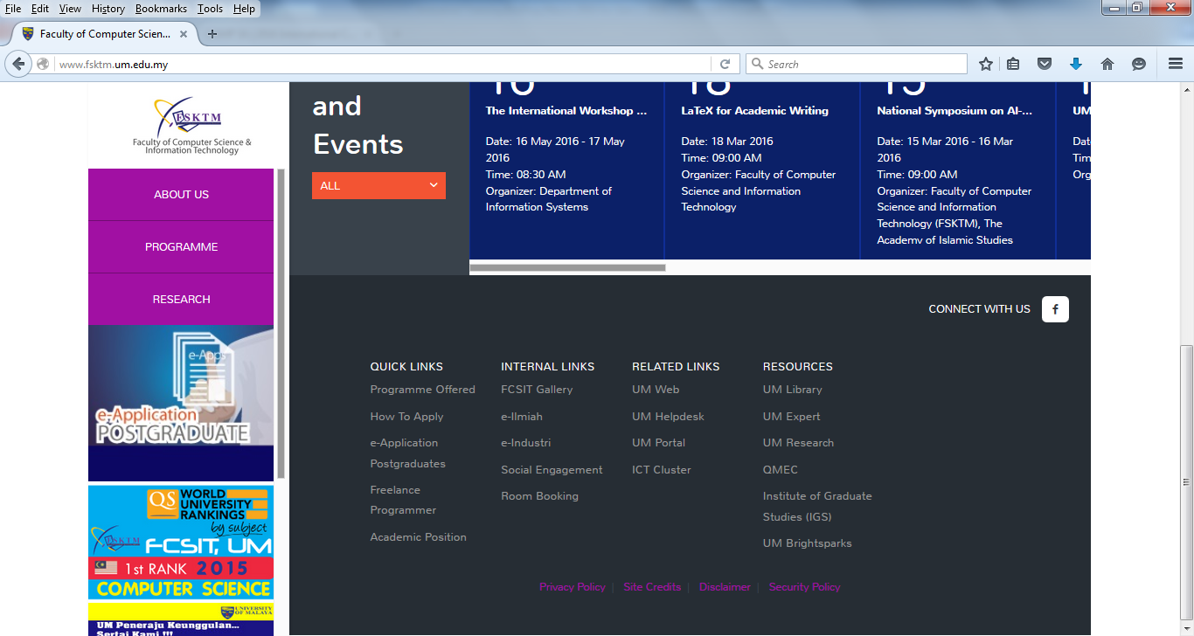
Industrial Training Web Site

Slide 46
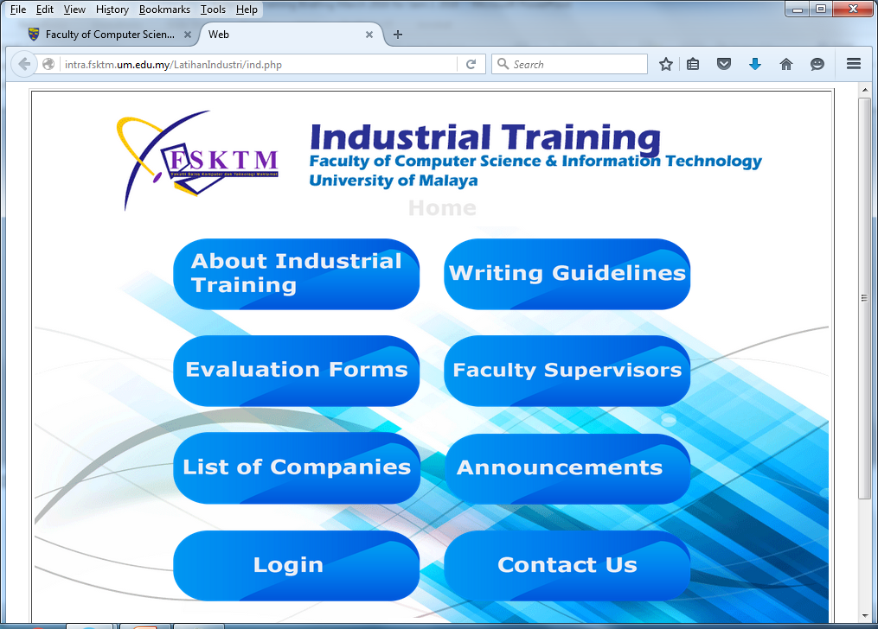
Industrial Training Web Site

Slide 47
Resume
Some companies requested for resume of students going for industrial training,
If you are interested, please email your resume to Mrs. Faridah and cc to dept. coordinator, by 30th November 2016.

Slide 48
Q & A

